Slide 1

Creativity and Innovation exploration

Slide 2
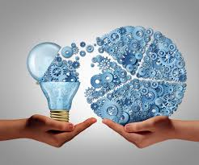
Creativity is the ability produce original ideas
Innovation is when these ideas result in something of value

Slide 3
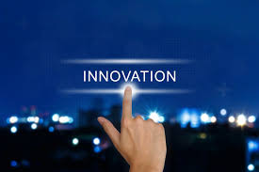
Innovations that made the world what it is today.

Slide 4
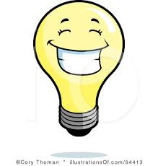

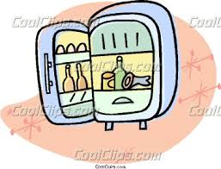



GLASS
REFRIGERATION
RECORDRD SOUND
WATER PURIFICATION
CLOCKS
ARTIFICIAL LIGHTS
Notes:
Steven Johnson interview ….

Slide 5
What else would you like to add?
Notes:
Page 21….

Slide 6

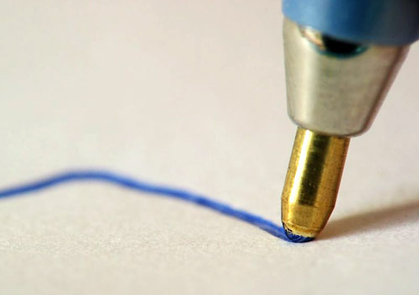
Innovation of the Past:
Ball Pen

Slide 7
László József Bíró was the inventor of the easy-to-use writing pen generally known as the biro in Britain and the ballpoint in the United States.

Slide 8
He conceived of a writing tool that would incorporate its own supply of fast-drying ink.

Slide 9
Laszlo Jozsef Bíró noticed that newspaper ink dried much more quickly than that from a fountain pen.

Slide 10
The stylistic writing of a fountain pen uses liquid ink, which needs to flow from the tip to the page.

Slide 11
But the quick-drying ink used by printing presses was too thick to drip.

Slide 12
Thinking of the problem of how to deliver thick, quick-drying ink to a paper surface without requiring the ink to flow, Bíró along with his brother George, saw a possible answer…

Slide 13
They closed the second end of the pen and instead of using a nib, left an opening with just enough room for a tiny metal ball that would spin against the ink in the reservoir, distributing it to the paper!

Slide 14
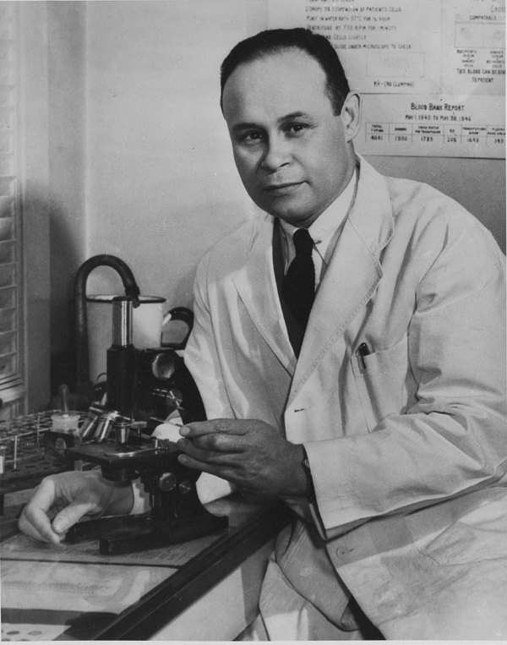
In the 1920’s, Richard Drew an American inventor was working at a company called 3M. He saw that the automotive painters were struggling to create a two tone look which was popular for the cars.

Slide 15
The techniques used by them such as putting newspapers over the already painted section or using existing tape to prevent paint transfer were often unsuccessful.

Slide 16
Drew, overheard the problems of the painters and got the idea to create a new tape that would seal so that the paint wouldn’t get through and also come off clean without leaving any residue.

Slide 17
It took him two years of experimentation with different types of adhesives that he applied to a crepe paper backing to come up with the right combination.

Slide 18
The first tape had adhesive along its edges but not in the middle.

Slide 19
In its first trial run, it fell off the car and the frustrated auto painter growled at Drew, "take this tape back to those Scotch bosses of yours and tell them to put more adhesive on it!”

Slide 20
By "Scotch," he meant "parsimonious".

Slide 21
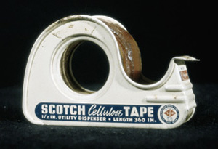
Thus, what would be called “Scotch” Masking Tape was born in 1925.

Slide 22
What might be an important innovation of the future?
Notes:
Page 21

Slide 23
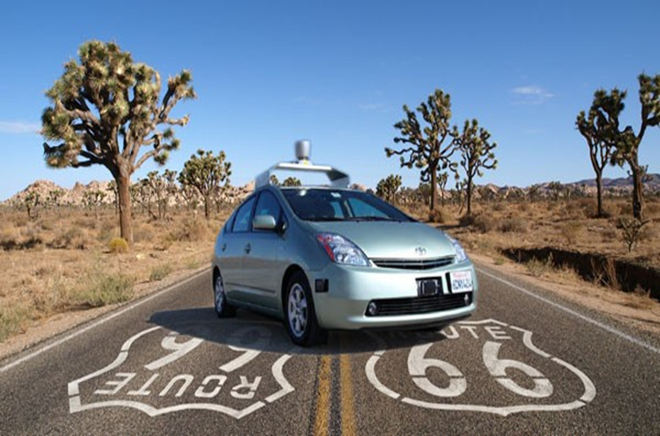
Google Driverless Car

Slide 24
Meet Robear. It’s a high-tech teddy with a mission: helping make elderly care much easier in the future.

Slide 25
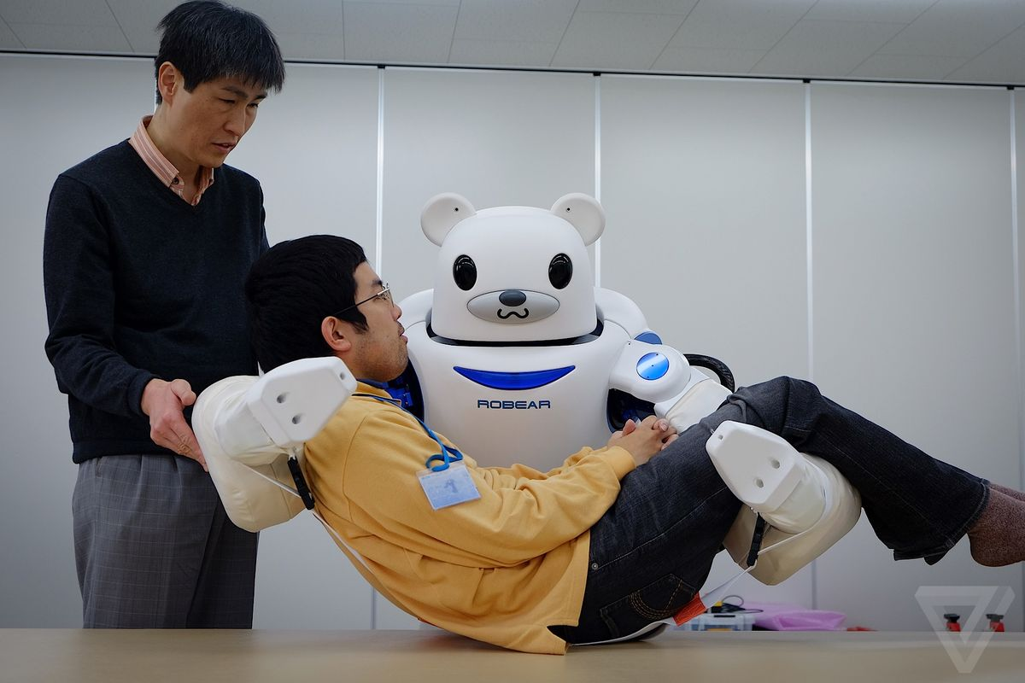

Slide 26
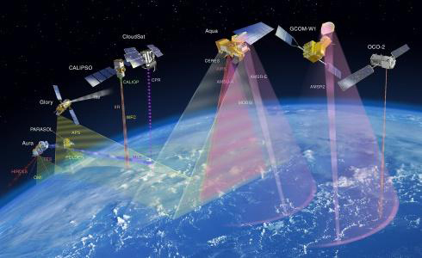
Remote Sensing

Slide 27
What is remote sensing used for?
Remote sensing is a method for getting information about of different objects on the planet, without any physical contacts with it.
Image Source: cimss.ssec.wisc.edu

Slide 28
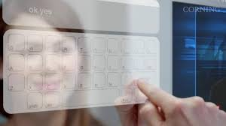
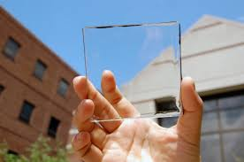
Innovation of the Future:
Photovoltaic Glass
This highly durable, efficient optical grade glass will be used in the future to allow any flat surface, from the mirror in your bathroom, to a picture hanging from the wall in your bedroom, to be used as an integrated computer screen.
*Reference: http://www.top10zen.com/10-amazing-innovations-of-the-near-future-243?page=3

Slide 29
Who is the most creative person you know?

Slide 30
Why do you think he/she is creative/ innovative?

Slide 31
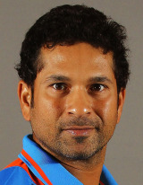
Sachin Tendulkar
Sportsperson
Regarded as one of the greatest cricketers of all time
Youngest sports person to receive the Bharat Ratna from the Government of India
“I always had a dream to play for India but I never let it put pressure on me.”

Slide 32
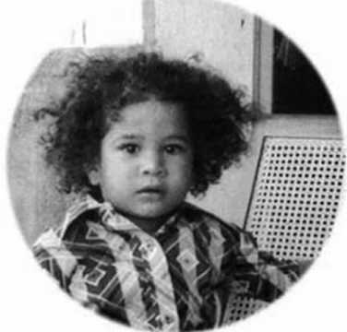
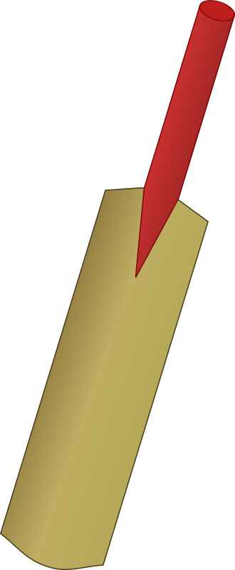
With sheer diligence and hard work coupled with natural talent the young Mumbaikar demonstrated the qualities that propelled him to the national team at the tender age of 16.

Slide 33
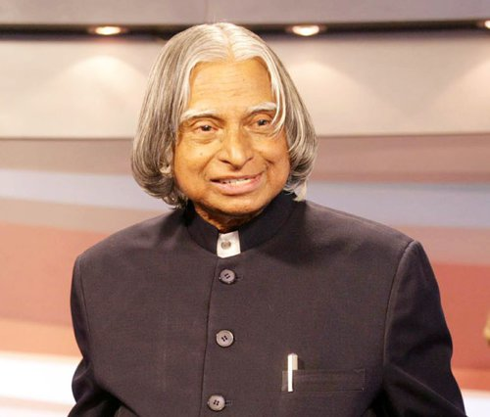
Dr APJ Abdul Kalam
Scientist, Educator, Leader and Writer
11th President of India, widely acknowledged as the “People’s President”
Wrote several noted books, including his autobiography , “Wings of Fire: An Autobiography.”
“If you want to shine like a sun. First burn like a sun.”

Slide 34
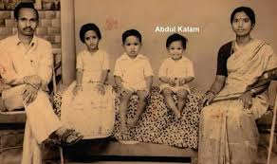
Kalam grew up in humble surroundings and had to take up a job while he was still in school. In order to augment his family’s meager income he distributed newspapers to help his father in providing for the family. He was a bright young boy, blessed with a thirst for knowledge and was always eager to learn new things.

Slide 35
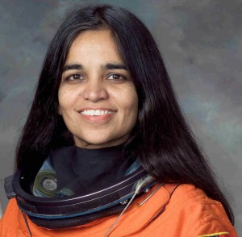
Kalpana Chawla
Scientist and Astronaut
DOB: March 16, 1972 | Karnal, Haryana, India
Died: February 1, 2003 | Space Shuttle Columbia disaster, while shuttle was re-entering into the earth’s atmosphere
First Indian woman in Space
"The path from dreams to success does exist. May you have the vision to find it, the courage to get on to it, and the perseverance to follow it. Wishing you a great journey.”

Slide 36
Kalpana Chawla's story is an absolutely inspiring one! It’s the story of an ordinary girl who dreamt big and reached for the stars…literally.
Chawla's mother has mentioned in an interview that her daughter was "different." "She used to cut her own hair, never wore ironed clothes, learned karate.

Slide 37
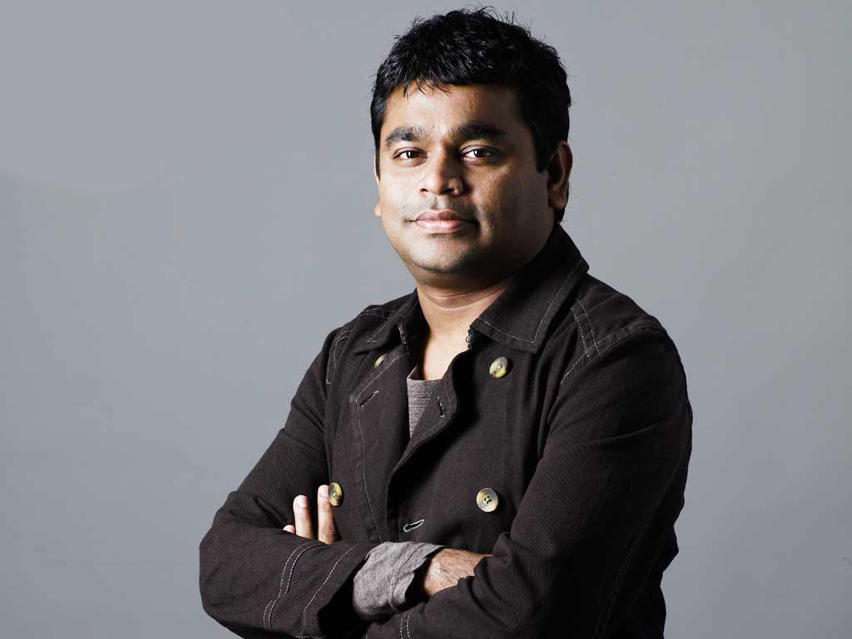
A.R Rahman
Music composer, Songwriter, Music Producer, Singer and Philanthropist
When you do something with a lot of honesty, appetite and commitment, the input reflects in the output.”
“

Slide 38

Key characteristics of creative persons

Slide 39
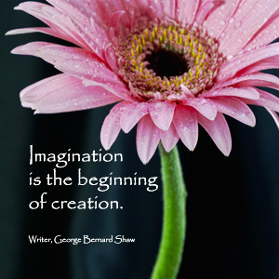

Slide 40
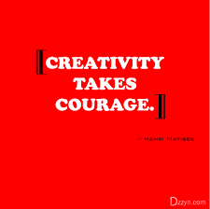

Slide 41
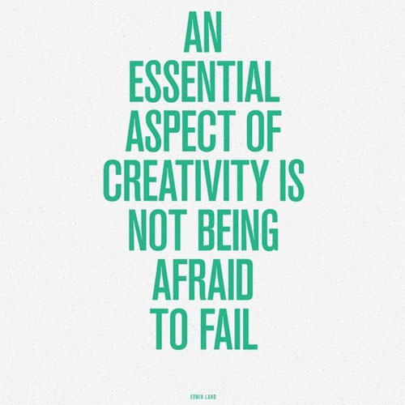

Slide 42
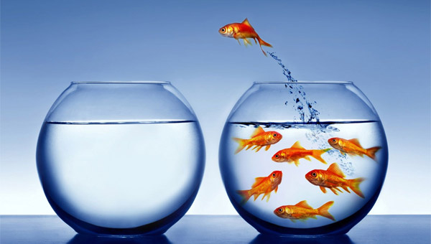
Think differently from the mainstream.

Slide 43
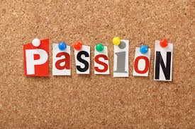

Slide 44
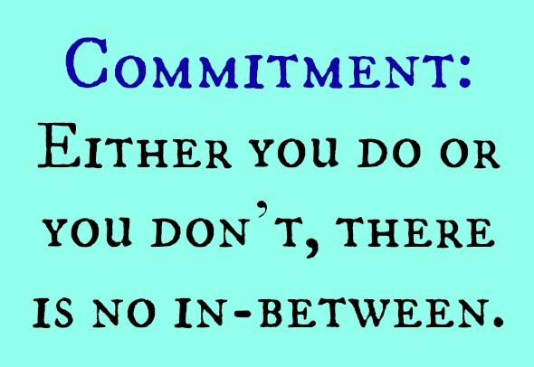

Slide 45



Slide 46


